Slide 1
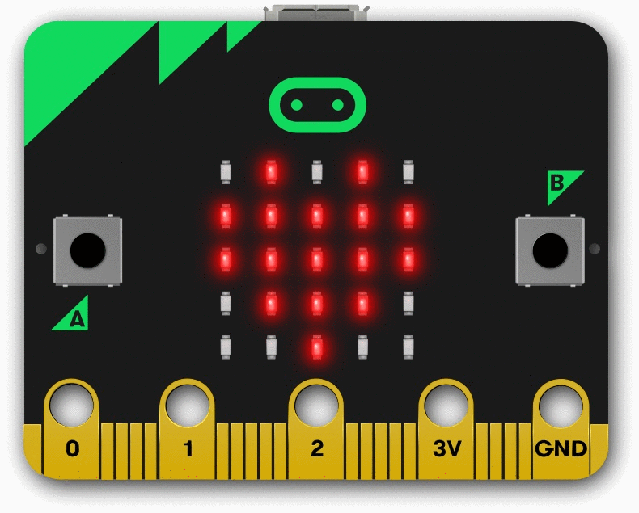
让我们开始学习 MicroBit 吧！
Mari Kita Belajar MicroBit!
Let's Start Learning MicroBit!
START

Slide 2
Table of Contents
Unit 1
MicroBit Learning Platform
Unit 2
Unit 1
Unit 2
Learn the basics of what a MicroBit is and how to set it up.
了解 MicroBit 的基础知识以及如何设置它。
Learn how to use MicroBit’s "Input" blocks to interact with sensors and buttons for creating interactive projects.
学习如何使用 MicroBit 的“输入”方块与传感器和按钮互动，创建交互式项目。
START
START

Slide 3
Table of Contents
Introduction to MicroBit
MicroBit简介
Unit 1 : Basic
MicroBit: On Start and Forever
MicroBit: 当开机时 和 无限循环
Introduction to MicroBit
MicroBit简介
MicroBit: On Start and Forever
MicroBit: 当开机时 和 无限循环
MicroBit: Basic Module Blocks
MicroBit: 基本模块
Unit Exercise: Basic
单元练习：Basic
Learn the basics of what a MicroBit is and how to set it up.
了解 MicroBit 的基础知识以及如何设置它。
Learn how to use the "On Start" and "Forever" blocks in Microbit to run actions when powered on and repeat tasks continuously.
学习如何使用“On Start”和“Forever”模块，让 Microbit 开机时执行任务并持续运行。
START
START
↓

Slide 4
Table of Contents
Introduction to MicroBit
MicroBit简介
Unit 1 : Basic
↑
MicroBit: On Start and Forever
MicroBit: 当开机时 和 无限循环
MicroBit: Basic Module Blocks
MicroBit: 基本模块
MicroBit: Basic Module Blocks
MicroBit: 基本模块
Unit Exercise: Basic
单元练习：Basic
Unit Exercise: Basic
单元练习：Basic
This article covers the key blocks in the MicroBit Basic module, such as "Show Number," "Show String," "Pause," and "Clear Screen," essential for controlling the display and timing in your projects.
本文介绍了 MicroBit 基本模块中的关键代码块，如“显示数字”、“显示字符串”、“暂停”和“清空屏幕”，帮助控制显示和时间。
START
START

Slide 5

Table of Contents
Introduction to MicroBit
MicroBit简介
Introduction to MicroBit
MicroBit简介
MicroBit: On Start and Forever
MicroBit: 当开机时 和 无限循环
MicroBit: Basic Module Blocks
MicroBit: 基本模块
Unit Exercise: Basic
单元练习：Basic
The MicroBit is a small, programmable microcontroller designed to make learning coding and electronics fun and accessible.
In this article, you'll learn the basics of what a MicroBit is and how to set it up for your first project.
MicroBit 是一款小型可编程微控制器，旨在让学习编码和电子产品变得有趣且易于操作。
在本文中，您将了解 MicroBit 的基本知识以及如何为您的第一个项目设置它。
Back to Learning Platform

Slide 6
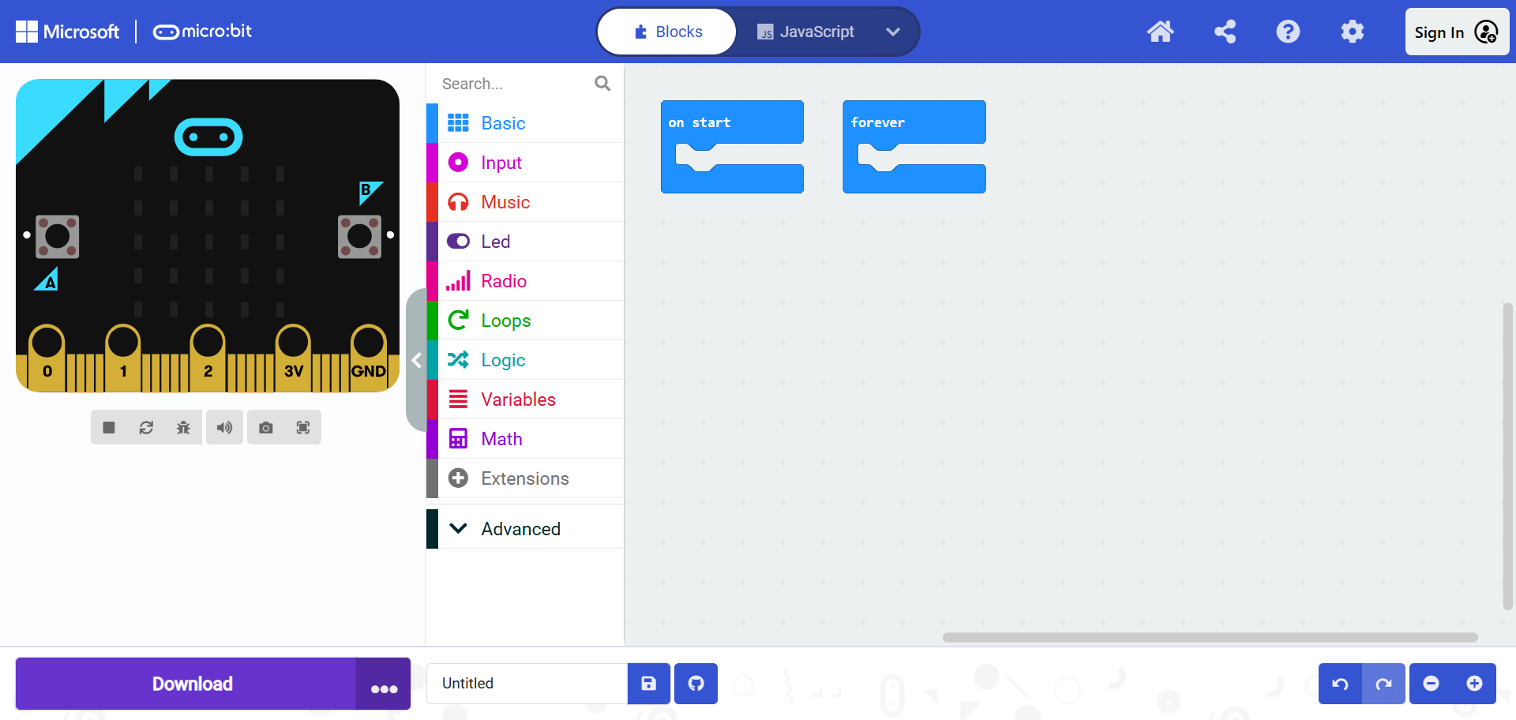
Table of Contents
Introduction to MicroBit
MicroBit简介
MicroBit: On Start and Forever
MicroBit: 当开机时 和 无限循环
MicroBit: On Start and Forever
MicroBit: 当开机时 和 无限循环
In MicroBit programming, On Start and Forever are key blocks that define how the microcontroller behaves when it starts and during continuous operation.
The On Start block is used to initialize variables, configure settings, or execute tasks that should only run once when the MicroBit is powered on or reset.
The Forever block is a loop that runs continuously after the On Start block has finished, making it ideal for tasks that need to repeat, such as checking sensor inputs or updating a display.
在 MicroBit 编程中，启动时 (On Start) 和 永远 (Forever) 是两个重要的代码块，定义了 MicroBit 在启动时和持续运行期间的行为。
当开机时 (On Start) 块用于初始化变量、配置设置或执行仅在 MicroBit 开机或重置时运行一次的任务。
无限循环 (Forever) 块是一个循环，在启动时代码块完成后会持续运行。它非常适合需要重复执行的任务，例如检查传感器输入或更新显示。
MicroBit: Basic Module Blocks
MicroBit: 基本模块
Unit Exercise: Basic
单元练习：Basic
Back to Learning Platform
Show / Hide Picture

Slide 7
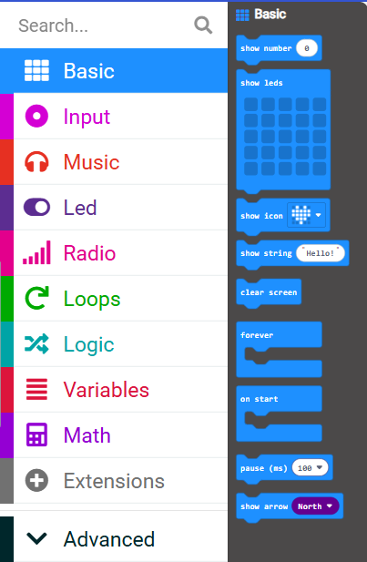
Table of Contents
Introduction to MicroBit
MicroBit简介
MicroBit: Basic Module Blocks
MicroBit: 基本模块
MicroBit: On Start and Forever
MicroBit: 当开机时 和 无限循环
In MicroBit programming, the Basic module contains several important blocks that allow you to control basic functions and actions. These blocks are essential for building interactive projects and controlling the MicroBit’s hardware components.
Some of the key blocks in the Basic module include:
Show Number: Displays a number on the MicroBit's LED display.
Show String: Displays a string of text on the LED display.
Pause: Pauses the program for a specified amount of time (in milliseconds).
Clear Screen: Clears the LED display.
These blocks are used to create simple, yet powerful interactions with the MicroBit, making it possible to display messages, pause actions, and clear the screen as needed in your program.
在 MicroBit 编程中，基本 (Basic) 模块包含多个重要的代码块，允许你控制基本功能和操作。这些模块是构建交互式项目和控制 MicroBit 硬件组件的基础。
基本模块中的一些关键代码块包括：
显示数字 (Show Number): 在 MicroBit 的 LED 显示屏上显示数字。
显示字符串 (Show String): 在 LED 显示屏上显示文本字符串。
暂停 (Pause): 暂停程序运行指定的时间（以毫秒为单位）。
清空屏幕 (Clear Screen): 清除 LED 显示屏上的内容。
这些代码块用于与 MicroBit 进行简单而强大的交互，可以在程序中根据需要显示信息、暂停操作或清除显示屏。
MicroBit: Basic Module Blocks
MicroBit: 基本模块
Unit Exercise: Basic
单元练习：Basic
Back to Learning Platform
Show / Hide Picture

Slide 8
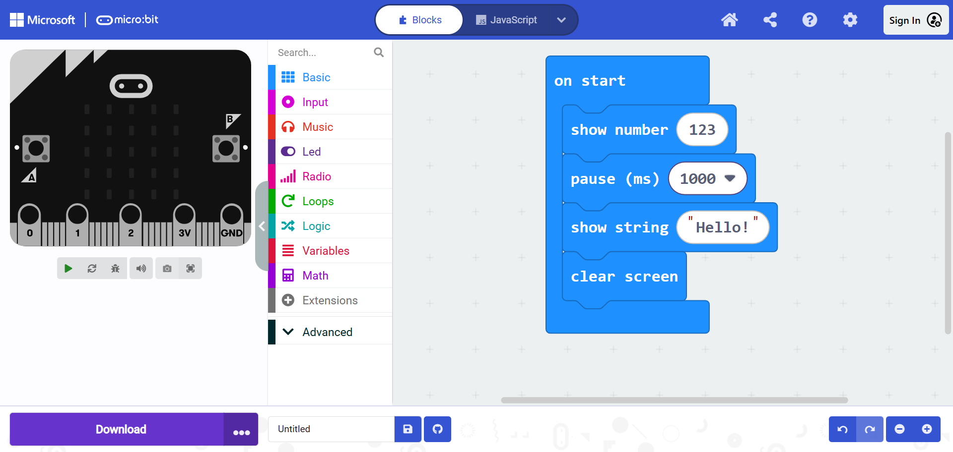
Google Form Test
Table of Contents
Introduction to MicroBit
MicroBit简介
Unit Exercise: Basic
单元练习: Basic
MicroBit: On Start and Forever
MicroBit: 当开机时 和 无限循环
This MicroBit code uses several blocks to display a number, pause, show a message, and clear the screen:
basic.showNumber(123): Displays the number 123 on the LED display.
basic.pause(1000): Pauses the program for 1000 milliseconds (1 second).
basic.showString("Hello!"): Displays the string "Hello!" on the LED display.
basic.clearScreen(): Clears the LED display, turning it off.
This sequence of blocks allows you to display a number, wait for a second, show a message, and then clear the display. It's useful for creating simple interactions with the MicroBit.
这段 MicroBit 代码使用了多个代码块来显示数字、暂停、显示消息并清空屏幕：
basic.showNumber(123): 在 LED 显示屏上显示数字 123。
basic.pause(1000): 暂停程序 1000 毫秒（1 秒）。
basic.showString("Hello!"): 在 LED 显示屏上显示字符串 "Hello!"。
basic.clearScreen(): 清空 LED 显示屏，将其关闭。
这组代码块让你可以显示一个数字、暂停一秒钟、显示消息，然后清空显示屏。非常适合用来创建简单的与 MicroBit 交互的项目。
MicroBit: Basic Module Blocks
MicroBit: 基本模块
Unit Exercise: Basic
单元练习：Basic
Back to Learning Platform
Show / Hide Picture

Slide 9
Table of Contents
MicroBit Input Blocks
MicroBit 输入方块
Unit 2 : Input
MicroBit Input Blocks
MicroBit 输入方块
Examples of "on"
Input Blocks
Examples of "on"
Input Blocks
START
START
Unit Exercise: Input
Unit Exercise: Input
START

Slide 10
Table of Contents
MicroBit Input Blocks
MicroBit 输入方块
In this unit, we will introduce the fundamental concepts behind the "Input" blocks in the MicroBit platform. The MicroBit is a small yet powerful device with a variety of sensors, buttons, and capabilities that allow it to interact with the world around it. Understanding how to use the input blocks will allow you to create projects that react to physical actions and environmental conditions.
In this unit, you will learn the following:
How to use input blocks for user interaction: You will learn how to use the input blocks to interact with the device through its physical buttons and the motion sensors. You can create programs that respond to button presses, shakes, or tilts.
How to handle sensor data: The MicroBit is equipped with various sensors, such as the light sensor and temperature sensor. In this unit, you will learn how to read and utilize data from these sensors in your projects.
How to use the accelerometer and compass: You'll discover how to use the MicroBit’s built-in accelerometer to detect movements such as shaking or tilting. The compass will allow you to create applications that use direction and orientation.
How to combine input blocks with other logic: We will explore how to combine input blocks with other logic blocks such as loops and conditionals. For example, you can make the MicroBit do something when a button is pressed or when the device is shaken.
Building interactive projects: By the end of this unit, you will be able to create interactive projects that respond to the user. For example, you can create a game where the MicroBit reacts when the user shakes the device, or a weather station that uses the temperature sensor to display the current temperature.
This unit is the foundation of creating interactive projects that can sense and respond to the environment or the user. You will be able to take your understanding of inputs and use them in a wide variety of applications, from simple games to useful sensor-based tools.
Back to Learning Platform

Slide 11
Table of Contents
Examples of "on"
Input Blocks
In this unit, you will learn about the "on" blocks in the MicroBit Input category, which are used to trigger actions based on specific events. These blocks allow your project to respond when something happens, such as a button press or an event in the environment.
Examples of "on" Input Blocks
on button A pressed: This block triggers an action when button A is pressed on the MicroBit.
on button B pressed: This block triggers an action when button B is pressed on the MicroBit.
on shake: This block triggers an action when the MicroBit is shaken.
on logo pressed: This block triggers an action when the MicroBit logo is pressed.
on pin pressed: This block triggers an action when a specific pin on the MicroBit is pressed.
These blocks are essential for creating interactive projects that respond to user input, movements, or physical interactions with the environment. By using these "on" blocks, you can make your MicroBit projects more dynamic and responsive to various actions.
Back to Learning Platform

Slide 12
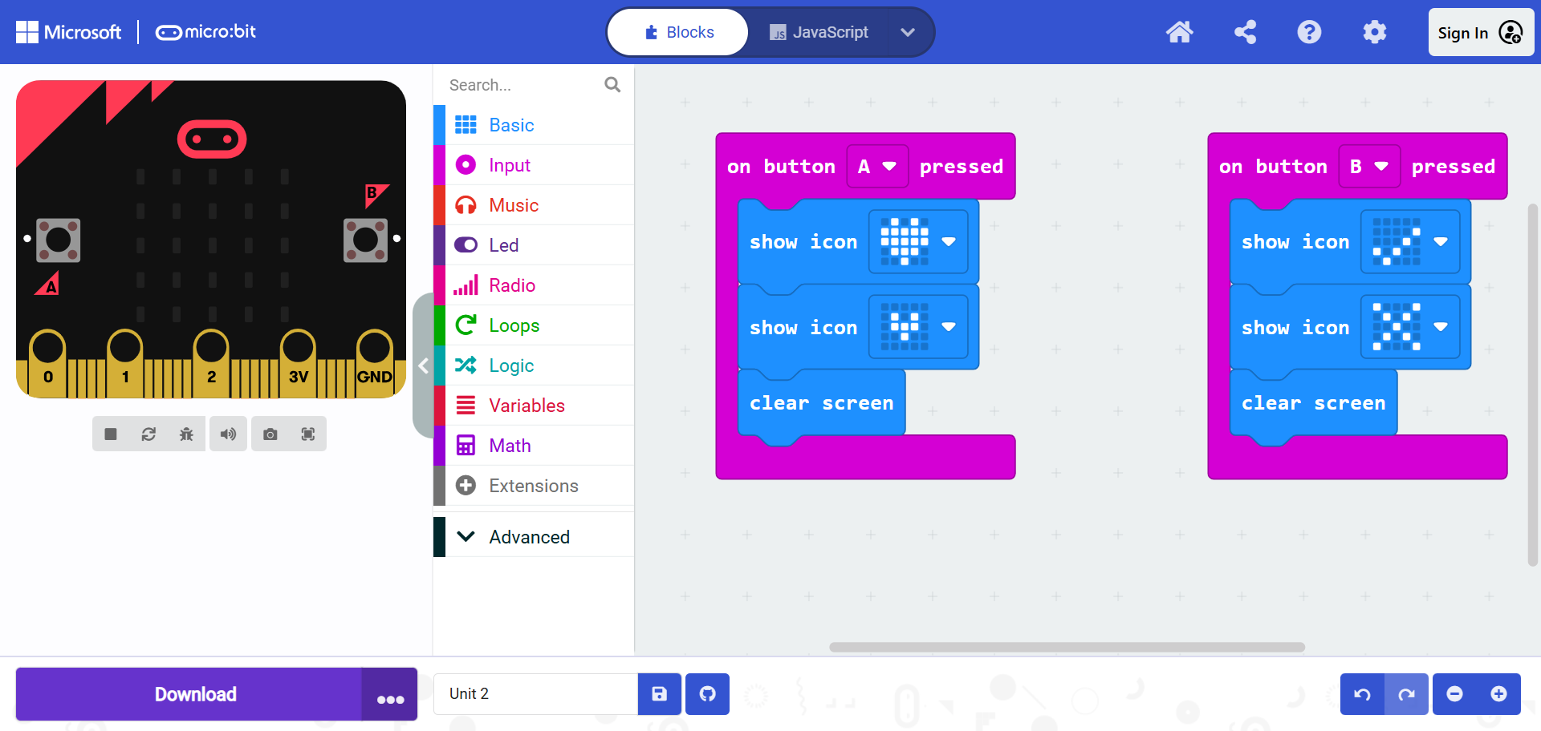
Google Form Test
Table of Contents
Examples of "on"
Input Blocks
Explanation of the Code
This code demonstrates how to use the MicroBit's button press events to trigger actions. The code uses the "onButtonPressed" block to define what should happen when either button A or button B is pressed on the MicroBit.
input.onButtonPressed(Button.A, function () { ... }): This block listens for a button A press event. When button A is pressed, the following actions are triggered:
  basic.showIcon(IconNames.Heart): Displays a heart icon on the MicroBit's LED display.
  basic.showIcon(IconNames.SmallHeart): Displays a smaller heart icon after the first heart icon.
  basic.clearScreen(): Clears the MicroBit's display, turning off all LEDs.
input.onButtonPressed(Button.B, function () { ... }): This block listens for a button B press event. When button B is pressed, the following actions are triggered:
  basic.showIcon(IconNames.Yes): Displays a "Yes" icon on the MicroBit's LED display.
  basic.showIcon(IconNames.No): Displays a "No" icon after the "Yes" icon.
  basic.clearScreen(): Clears the MicroBit's display, turning off all LEDs.
In summary, this code demonstrates how to use button presses to trigger different actions. Pressing button A shows a heart icon sequence, and pressing button B shows a "Yes" and "No" icon sequence. The screen is cleared after each sequence.
Back to Learning Platform
Show / Hide Picture

